Slide 1
System Security
Module-VI

Slide 2
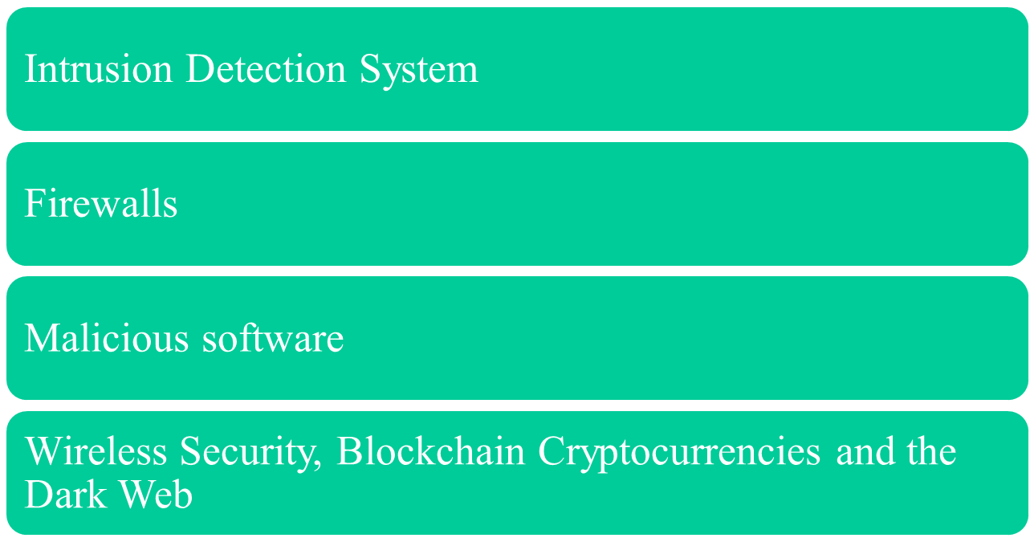
Contents

Slide 3
Intrusion Detection

Slide 4
Intrusion and Intrusion Detection
Intrusion : Attempting to break into or misuse your system.
Intruders may be from outside the network or legitimate users of the network.
Intrusion can be a physical, system or remote intrusion.

Slide 5
Intrusion Detection Systems (IDS)
Intrusion Detection Systems look for attack signatures, which are specific patterns that usually indicate malicious or suspicious intent.

Slide 6
Intrusion Detection Systems (IDS)
Different ways of classifying an IDS
IDS based on
  anomaly detection
  signature based misuse
  host based
  network based

Slide 7
Anomaly based IDS
This IDS models the normal usage of the network as a noise characterization.
Anything distinct from the noise is assumed to be an intrusion activity.
  E.g flooding a host with lots of packet.
The primary strength is its ability to recognize novel attacks.

Slide 8
Drawbacks of Anomaly detection IDS
Assumes that intrusions will be accompanied by manifestations that are sufficiently unusual so as to permit detection.
These generate many false alarms and hence compromise the effectiveness of the IDS.

Slide 9
Signature based IDS
This IDS possess an attacked description that can be matched to sensed attack manifestations.
The question of what information is relevant to an IDS depends upon what it is trying to detect.
  E.g DNS, FTP etc.

Slide 10
Signature based IDS (contd.)
ID system is programmed to interpret a certain series of packets, or a certain piece of data contained in those packets,as an attack. For example, an IDS that watches web servers might be programmed to look for the string “phf” as an indicator of a CGI program attack.
Most signature analysis systems are based off of simple pattern matching algorithms. In most cases, the IDS simply looks for a sub string within a stream of data carried by network packets. When it finds this sub string (for example, the ``phf'' in ``GET /cgi-bin/phf?''), it identifies those network packets as vehicles of an attack.

Slide 11
Drawbacks of Signature based IDS
They are unable to detect novel attacks.
Suffer from false alarms
Have to programmed again for every new pattern to be detected.

Slide 12
Host/Applications based IDS
The host operating system or the application logs in the audit information.
These audit information includes events like the use of identification and authentication mechanisms (logins etc.) , file opens and program executions, admin activities etc.
This audit is then analyzed to detect trails of intrusion.

Slide 13
Drawbacks of the host based IDS
The kind of information needed to be logged in is a matter of experience.
Unselective logging of messages may greatly increase the audit and analysis burdens.
Selective logging runs the risk that attack manifestations could be missed.

Slide 14
Strengths of the host based IDS
Attack verification
System specific activity
Encrypted and switch environments
Monitoring key components
Near Real-Time detection and response.
No additional hardware

Slide 15
Stack based IDS
They are integrated closely with the TCP/IP stack, allowing packets to be watched as they traverse their way up the OSI layers.
This allows the IDS to pull the packets from the stack before the OS or the application have a chance to process the packets.

Slide 16
Network based IDS
This IDS looks for attack signatures in network traffic via a promiscuous interface.
A filter is usually applied to determine which traffic will be discarded or passed on to an attack recognition module. This helps to filter out known un-malicious traffic.

Slide 17
Strengths of Network based IDS
Cost of ownership reduced
Packet analysis
Evidence removal
Real time detection and response
Malicious intent detection
Complement and verification
Operating system independence

Slide 18
Commercial ID Systems
ISS – Real Secure from Internet Security Systems:
  Real time IDS.
  Contains both host and network based IDS.
Tripwire – File integrity assessment tool.
Bro and Snort – open source public-domain system.

Slide 19
Future of IDS
To integrate the network and host based IDS for better detection.
Developing IDS schemes for detecting novel attacks rather than individual instantiations.

Slide 20
Firewalls

Slide 21
Outline
Firewall Design Principles
  Firewall Characteristics
  Types of Firewalls
  Firewall Configurations

Slide 22
Firewalls
Effective means of protection a local system or network of systems from network-based security threats while affording access to the outside world via WAN`s or the Internet

Slide 23
Firewall Design
Principles
The firewall is inserted between the premises network and the Internet
Aims:
  Establish a controlled link
  Protect the premises network from Internet-based attacks
  Provide a single choke point

Slide 24
Firewall Characteristics
Design goals:
  All traffic from inside to outside must pass through the firewall (physically blocking all access to the local network except via the firewall)
  Only authorized traffic (defined by the local security police) will be allowed to pass

Slide 25
Firewall Characteristics
Design goals:
  The firewall itself is immune to penetration (use of trusted system with a secure operating system)

Slide 26
Types of Firewalls
Three common types of Firewalls:
  Packet-filtering routers
  Application-level gateways
  Circuit-level gateways

Slide 27
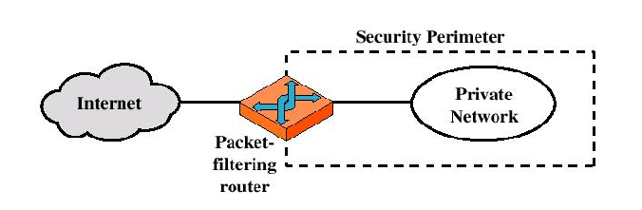
Types of Firewalls
Packet-filtering Router

Slide 28
Types of Firewalls
Packet-filtering Router
  Applies a set of rules to each incoming IP packet and then forwards or discards the packet
  Filter packets going in both directions
  The packet filter is typically set up as a list of rules based on matches to fields in the IP or TCP header
  Two default policies (discard or forward)

Slide 29
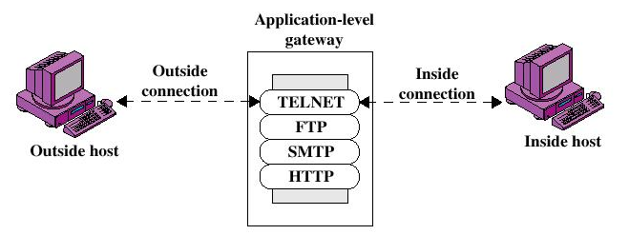
Types of Firewalls
Application-level Gateway

Slide 30
Types of Firewalls
Application-level Gateway
  Also called proxy server
  Acts as a relay of application-level traffic

Slide 31
Types of Firewalls
Advantages:
  Higher security than packet filters
  Only need to scrutinize a few allowable applications
  Easy to log and audit all incoming traffic
Disadvantages:
  Additional processing overhead on each connection (gateway as splice point)

Slide 32
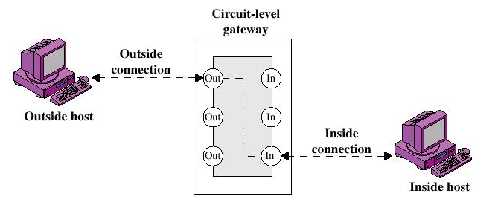
Types of Firewalls
Circuit-level Gateway

Slide 33
Types of Firewalls
Circuit-level Gateway
  Stand-alone system or
  Specialized function performed by an Application-level Gateway
  Sets up two TCP connections
  The gateway typically relays TCP segments from one connection to the other without examining the contents

Slide 34
Malicious Software
What is the concept of defense: The parrying of a blow. What is its characteristic feature: Awaiting the blow.
—On War, Carl Von Clausewitz

Slide 35
Viruses and Other Malicious Content
computer viruses have got a lot of publicity
one of a family of malicious software
effects usually obvious
have figured in news reports, fiction, movies (often exaggerated)
getting more attention than deserve
are a concern though

Slide 36
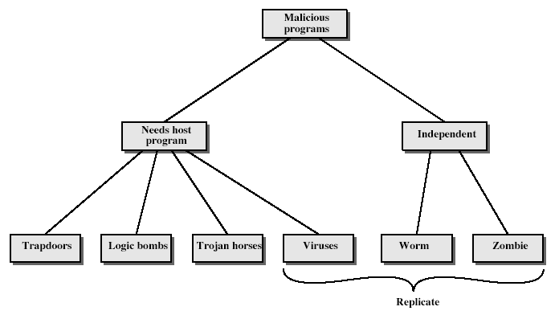
Malicious Software
Notes:
Stallings Fig 19-1.
Taxonomy can be divided into two categories: those that need a host program, and those that are independent;
can also differentiate between those software threats that do not replicate and those that do.

Slide 37
Trapdoors
secret entry point into a program
allows those who know access bypassing usual security procedures
have been commonly used by developers
a threat when left in production programs allowing exploited by attackers
very hard to block in O/S
requires good s/w development & update

Slide 38
Logic Bomb
one of oldest types of malicious software
code embedded in legitimate program
activated when specified conditions met
  eg presence/absence of some file
  particular date/time
  particular user
when triggered typically damage system
  modify/delete files/disks

Slide 39
Trojan Horse
program with hidden side-effects
which is usually superficially attractive
  eg game, s/w upgrade etc
when run performs some additional tasks
  allows attacker to indirectly gain access they do not have directly
often used to propagate a virus/worm or install a backdoor
or simply to destroy data

Slide 40
Zombie
program which secretly takes over another networked computer
then uses it to indirectly launch attacks
often used to launch distributed denial of service (DDoS) attacks
exploits known flaws in network systems

Slide 41
Viruses
a piece of self-replicating code attached to some other code
  cf biological virus
both propagates itself & carries a payload
  carries code to make copies of itself
  as well as code to perform some covert task

Slide 42
Virus Operation
virus phases:
  dormant – waiting on trigger event
  propagation – replicating to programs/disks
  triggering – by event to execute payload
  execution – of payload
details usually machine/OS specific
  exploiting features/weaknesses

Slide 43
Types of Viruses
can classify on basis of how they attack
parasitic virus
memory-resident virus
boot sector virus
stealth
polymorphic virus
macro virus

Slide 44
Macro Virus
macro code attached to some data file
interpreted by program using file
  eg Word/Excel macros
  esp. using auto command & command macros
code is now platform independent
is a major source of new viral infections
blurs distinction between data and program files making task of detection much harder
classic trade-off: "ease of use" vs "security"

Slide 45
Email Virus
spread using email with attachment containing a macro virus
  cf Melissa
triggered when user opens attachment
or worse even when mail viewed by using scripting features in mail agent
usually targeted at Microsoft Outlook mail agent & Word/Excel documents

Slide 46
Worms
replicating but not infecting program
typically spreads over a network
  cf Morris Internet Worm in 1988
  led to creation of CERTs
using users distributed privileges or by exploiting system vulnerabilities
widely used by hackers to create zombie PC's, subsequently used for further attacks, esp DoS
major issue is lack of security of permanently connected systems, esp PC's

Slide 47
Worm Operation
worm phases like those of viruses:
  dormant
  propagation
    search for other systems to infect
    establish connection to target remote system
    replicate self onto remote system
  triggering
  execution

Slide 48
Morris Worm
best known classic worm
released by Robert Morris in 1988
targeted Unix systems
using several propagation techniques
  simple password cracking of local pw file
  exploit bug in finger daemon
  exploit debug trapdoor in sendmail daemon
if any attack succeeds then replicated self

Slide 49
Recent Worm Attacks
new spate of attacks from mid-2001
Code Red
  exploited bug in MS IIS to penetrate & spread
  probes random IPs for systems running IIS
  had trigger time for denial-of-service attack
  2nd wave infected 360000 servers in 14 hours
Code Red 2
  had backdoor installed to allow remote control
Nimda
  used multiple infection mechanisms
    email, shares, web client, IIS, Code Red 2 backdoor

Slide 50
Virus Countermeasures
viral attacks exploit lack of integrity control on systems
to defend need to add such controls
typically by one or more of:
  prevention - block virus infection mechanism
  detection - of viruses in infected system
  reaction - restoring system to clean state

Slide 51


